Slide 1



#Ionic Notes
React JS Class Day 1

Slide 3
What is React JS ?
React (JavaScript library) In computing, React (also known as React.js or ReactJS) is a JavaScript library for building user interfaces.
It is maintained by Facebook and a community of individual developers and companies. React can be used as a base in the development of single-page or mobile applications.

Slide 4
It will create layer layout
We can create single page application
MVC Pattern to Develop WebApp

Slide 5
How to Install React JS ?
Install
npm install -g create-react-app
Create New Project
create-react-app my-app
Navigate to Folder
cd my-app
Run Project
npm start

Slide 6
Run Project in Browser
By Default Project will Run on Port No 3000
http://localhost:3000

Slide 7
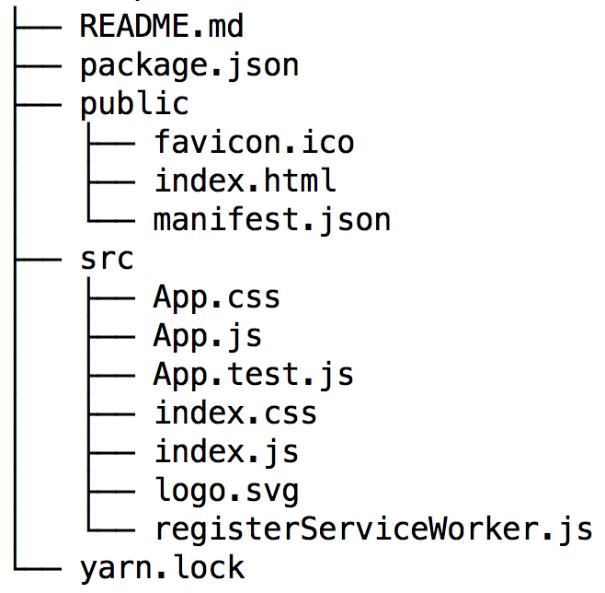
Directory Structure

Slide 8
Components
Everything in React is a component, and these usually take the form of JavaScript classes. You create a component by extending upon the React-Component class. Let’s create a component called Hello.
class Hello extends React.Component { render() { return <h1>Hello world!</h1>; } }

Slide 9


Get Exclusive
Video Tutorials
www.aptutorials.com
https://www.youtube.com/user/Akashtips

Slide 10


Get More Details
www.akashsir.com

Slide 11





If You Liked It !
Rating Us Now
Just Dial
https://www.justdial.com/Ahmedabad/Akash-Technolabs-Navrangpura-Bus-Stop-Navrangpura/079PXX79-XX79-170615221520-S5C4_BZDET
Sulekha
https://www.sulekha.com/akash-technolabs-navrangpura-ahmedabad-contact-address/ahmedabad

Slide 12





Connect With Me
# Social Info
Akash.padhiyar
Akashpadhiyar
Akash Padhiyar
#AkashSir
Akash_padhiyar
+91 99786-21654
www.akashsir.com
www.akashtechnolabs.com www.akashpadhiyar.com www.aptutorials.com
#Akashpadhiyar
#aptutorials

